Slide 1
Gym - Helper
Andy Patrick, Team GO

Slide 2
Why Make Gym-Helper?
Make something I can use
Other apps are too complicated
Cater to casual gym goer
Connect and share
Connect with a specific demographic

Slide 3
Tech Used
React
HTML5
CSS
BootStrap
Jquery
Node
Express
MongoDB
Passport
Bcrypt
React-router-dom

Slide 4
Demo

Slide 5
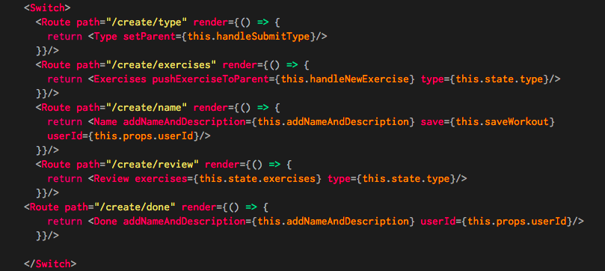
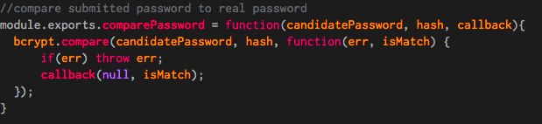
Problems
Multi component form
React-router-dom
Authentication
Passport
Custom Methods

Slide 8
Updates
Add Music – Spotify, Pandora, etc.
Likes, comments, sharing
Add news feed/ articles
Variable Reward
Push notification – email offers
Trigger user to use app
Buy supplements directly from app

Slide 9
Value Proposition
Targets a specific demographic
Global Sports Nutrition Market- $45 Billion by 2022
Zion Market Research
Sports and Fitness Clothing Market - $231 Billion by 2024
Global Industry Analysts, Inc.
Sponsored users, workouts, Popular athletes
Offer discounts

